Slide 1

Real-Time Weather Monitoring System with AWS IoT Core and DynamoDB
Name: D Revanth kumar
Roll No : 2210030452
Guide Name: Ms. P. Sree Lakshmi

Slide 2

Introduction
Overview of the Project:
The project involves developing a real-time weather monitoring system using AWS IoT Core for data ingestion and DynamoDB for storage.
Sensors collect temperature, humidity, and pressure data, which is processed and stored in a scalable AWS cloud environment.
Purpose & Expected Outcome:
Enable real-time monitoring of environmental parameters.
Store and analyze large amounts of weather data efficiently.
Provide an API to access weather data for further applications like forecasting.

Slide 3

AWS Services Used and Justification
AWS Service | Justification
AWS IoT Core | Connects IoT sensors securely and streams real-time weather data.
DynamoDB | NoSQL database for storing high-velocity data streams efficiently.
AWS Lambda | Processes incoming sensor data without managing servers.
Amazon API Gateway | Provides RESTful API access to stored weather data.
Amazon API Gateway | Provides RESTful API access to stored weather data.

Slide 4
System Architecture and Workflow
IoT-enabled sensors collect weather data.
Data is sent securely to AWS IoT Core via MQTT protocol.
AWS IoT Core triggers AWS Lambda functions for data processing.
Processed data is stored in DynamoDB for scalable and efficient querying.
API Gateway exposes the data for external applications (e.g., dashboards, mobile apps).
Amazon S3 is used for historical data archiving.

Slide 5
AWS Infrastructure Setup
Setting Up AWS IoT Core:
Create an IoT thing and attach certificates for secure communication.
Configure MQTT topics for publishing weather data.
Configuring DynamoDB:
Define table structure: WeatherData (sensor_id, timestamp, temperature, humidity, pressure).
Enable auto-scaling and on-demand read/write capacity.
Lambda Integration:
Write a Python function to process incoming IoT data and store it in DynamoDB.
Deploy using AWS Lambda console with appropriate IAM roles.

Slide 6
Security & IAM Policies
Implement AWS IAM roles and permissions:
Grant AWS IoT Core permission to invoke Lambda functions.
Allow Lambda to write to DynamoDB and store logs in S3.
Use AWS IAM policies to restrict access to API Gateway endpoints.
MQTT Security Measures:
Use AWS IoT Core X.509 certificates for device authentication.
Encrypt data in transit using TLS 1.2.

Slide 7
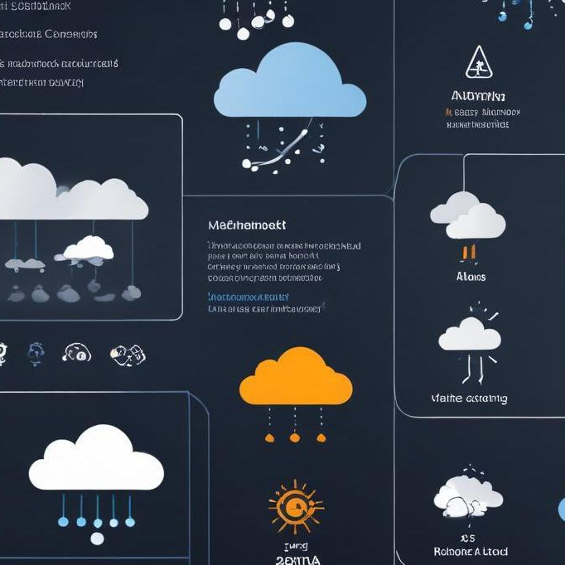
Continuous Deployment Strategy: Use AWS CodePipeline and CodeDeploy to automate Lambda updates. Deploy API changes with AWS CloudFormation. Monitoring and Alerts: Use AWS CloudWatch to monitor IoT device connectivity and database performance. Set up AWS SNS alerts for anomalies (e.g., sensor failures, data spikes).
Automation & CI/CD Pipeline

Slide 8
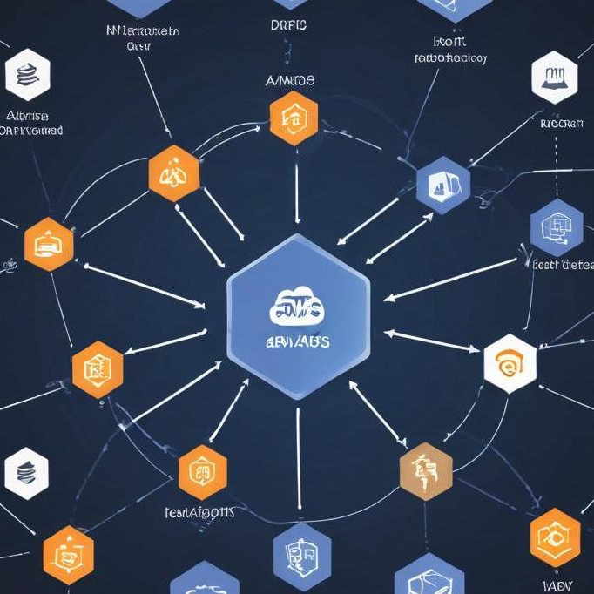
Conclusion
The Real-Time Weather Monitoring System efficiently collects, processes, and stores environmental data.
AWS IoT Core and DynamoDB ensure scalability and security.

